Slide 1
Caption And Audio Generation Of Image Using Machine Learning

Slide 2
Agenda
Introduction
Related Work
Architecture
Model Description
Conclusion
References

Slide 3
Introduction
Image Caption Generator is outputting correct and concise description of given image. So, Automated captioning of images demands an understand of the fields of computer vision as well as natural language processing.
Automated captioning is useful in situation where an image takes time to load , unavailable and where the image classification is necessary.
It can be applied to many areas such as web searching, education, the military, biomedicine, commerce, digital libraries, etc. Social media platforms such as Facebook , Twitter and Instagram are able to directly generate descriptions from images.
CNN model is responsible for image feature extraction. These extracted features will be fed to LSTM model which in turn generates the image Caption

Slide 4
Continue…
CNN is basically used for image classification and identification. It scans images from left to right and top to bottom to pull out important features from the image and combines the feature to classify images.
LSTM stands for Long Short Term Memory , they are part of RNN which is well suited for sequence prediction problems. Based on previous text , we can predict what the next word will be.
It has proven itself effective from traditional RNN by over coming the limitations of RNN which had short term memory. LSTM can carry out relevant information throughout the processing of inputs with forget gate, it discards no relevant information

Slide 5
Related Work
Kiros et al. were one of the first to propose a work in this area. The proposed method employs a CNN for extracting image features and uses a multimodal space that represents both image and text together for multimodal representation learning and image caption generation.
Kiros et al. extended their work in where LSTM is employed for sentence encoding and introduced a novel neural language model called the structure-content neural language model (SC-NLM) for image captions generations, to learn a joint image sentence embedding.

Slide 6
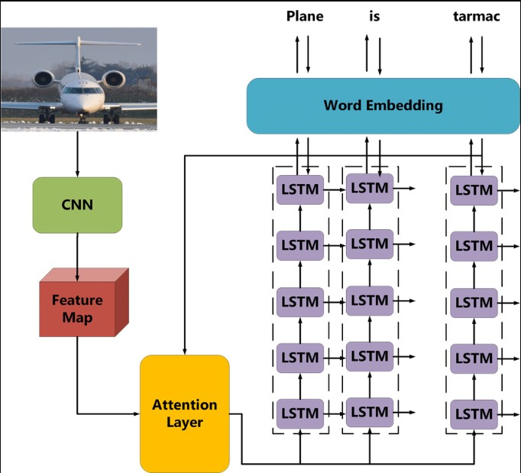
Architecture

Slide 7
Model Description
Training module

